Slide 1
Azure IaaS Intro to VMs and Virtual Networks
Santosh Hari

Slide 2
Agenda
Why VMs
Create Win Virtual Machine w/ Virtual Network
Create Linux Virtual Machine & add to Virtual Network
VMs communicate with each other
Some general concepts like SLA and extensions (if time permits)
Notes:
Instead of selling VMs, let’s discuss some scenarios in which we can use the VM approach

Slide 3
Virtual Machines

Slide 4
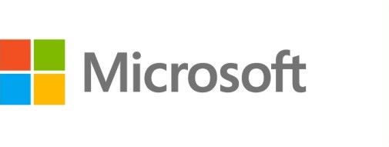



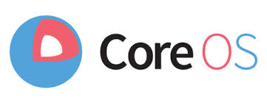


Azure Virtual Machines
Launch Windows Server and Linux in minutes
Scale from 1 to 1000s of VM Instances
Save money with per-minute billing
Open and extensible
Notes:
Slide Objectives:
High-level selling points of virtual machines.
Speaker Notes:
Both Linux and Windows are supported. It’s important to reiterate on this as many developers are still not aware of this.
Mention scaling at enterprise level using DSC, Puppet or Chef.
Emphasize on the openness – we are not forcing your to lock on Microsoft technologies. Instead, Azure is more open than ever. You can leverage your existing skills, tools and services, and Azure is providing more and more first-class supports for them.

Slide 5
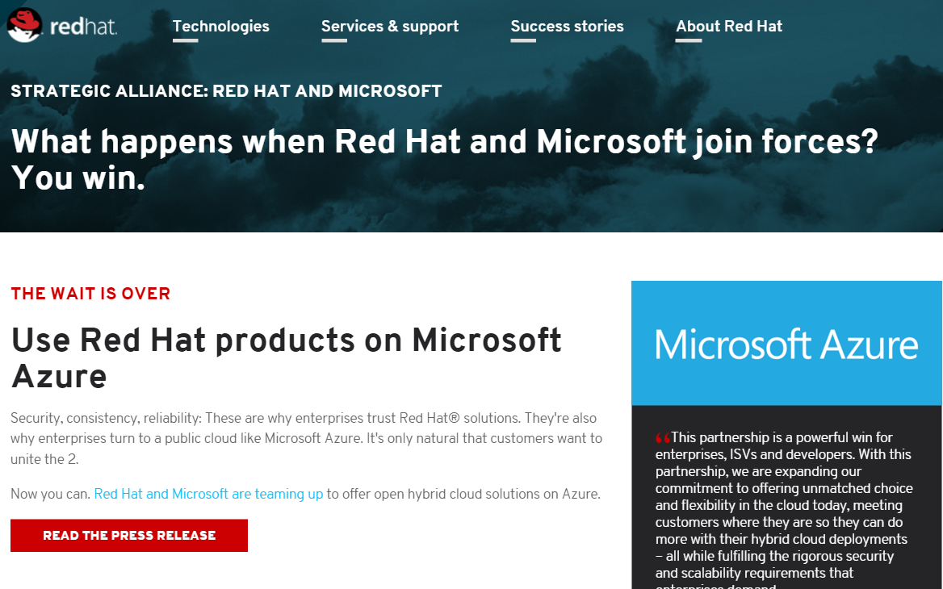
Announcing - now on Azure
Notes:
Slide Objectives:
High-level selling points of virtual machines.
Speaker Notes:
Both Linux and Windows are supported. It’s important to reiterate on this as many developers are still not aware of this.
Mention scaling at enterprise level using DSC, Puppet or Chef.
Emphasize on the openness – we are not forcing your to lock on Microsoft technologies. Instead, Azure is more open than ever. You can leverage your existing skills, tools and services, and Azure is providing more and more first-class supports for them.

Slide 6
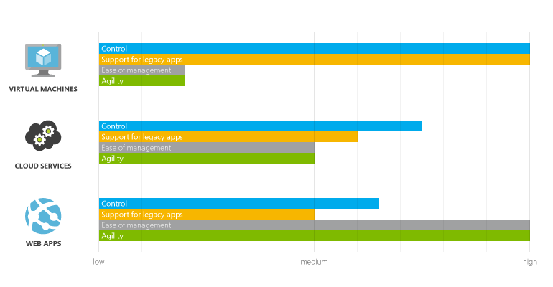
Why VMs
https://azure.microsoft.com/en-us/documentation/articles/choose-web-site-cloud-service-vm/

Slide 7


Provisioning VM
Getting Started
Select Image and VM Size
New Disk Persisted in Storage
Windows Server
Management Portal
Boot VM from New Disk
Linux
>_
General Purpose
Basic
Standard
Optimized Compute
Performance Optimized
Network Optimized
Scripting
(Windows, Linux and Mac)
Cloud
REST API
Notes:
Slide Objective:
Explain workflow for provisioning VMs in the cloud
Speaker Notes:
You have three methods of starting this process: Build a VM from the portal, from the command line OR programmatically calling the REST API.
Once your choice of provisioning is made you will need to select the image and instance size to start from.
The newly created disk will be stored in blob storage and your machine will boot.

Slide 8

















VM Gallery
A collection of prebuilt images for various workloads
Windows Server 2012 R2
Ubuntu Server 14.04 LTS
CentOS 6.5
SUSE Linux
Enterprise Server
openSUSE 13.1
Oracle Linux 6.4.0.0.0
SQL Server 2014 Standard
Oracle Database 11g R2
SharePoint Server Farm
Microsoft Dynamics
GP 2013
Zulu 8
BizTalk Server 2013
SAP HANA
Developer Edition
Puppet Enterprise 3.2.3
Barracuda Web Application
Oracle WebLogic
Server 12.1.2
Visual Studio Ultimate 2013
Windows 8.1 Enterprise
Notes:
Slide Objective:
Explain a wide variety of images that you can choose from.
Speaker Notes:
First of all, you can choose from different Windows Servers and a variety of Linux implementations. [Click]
As well as pre-built images for different flavors of SQL Database and Oracle databases. [Click]
You can also choose from a number of first-party and certified third-party images for various application servers and infrastructural components. [Click]
And last but not least, if you are a MSDN subscriber, you also have access to Visual Studio images and client Windows systems such as Windows 7 and Windows 8.1 for your DevTest purposes.

Slide 9
Virtual Machine Sizes
General Purpose compute: Basic
General Purpose compute: Standard
Optimized Compute
Performance Optimized
Network Optimized
Notes:
Slide Objective:
Introduce different virtual machine sizes.
Speaker Notes:
http://azure.microsoft.com/en-us/pricing/details/virtual-machines/

Slide 10
Scale-up options
Highest value
Largest scale-up
A
D
G
N
DV2
Highest value
Most memory fastest CPUs
GPU-enabled virtual machines
SSD Storage Fast CPUs
>80,000 IOPs
Premium Storage
New generation of D family VMs
35% faster than D
Intel E5-2673 v3 CPUs
NVIDIA GPUs
Remote visualization
Compute-intensive + RDMA
Largest virtual machines Fastest storage in the public cloud

Slide 11
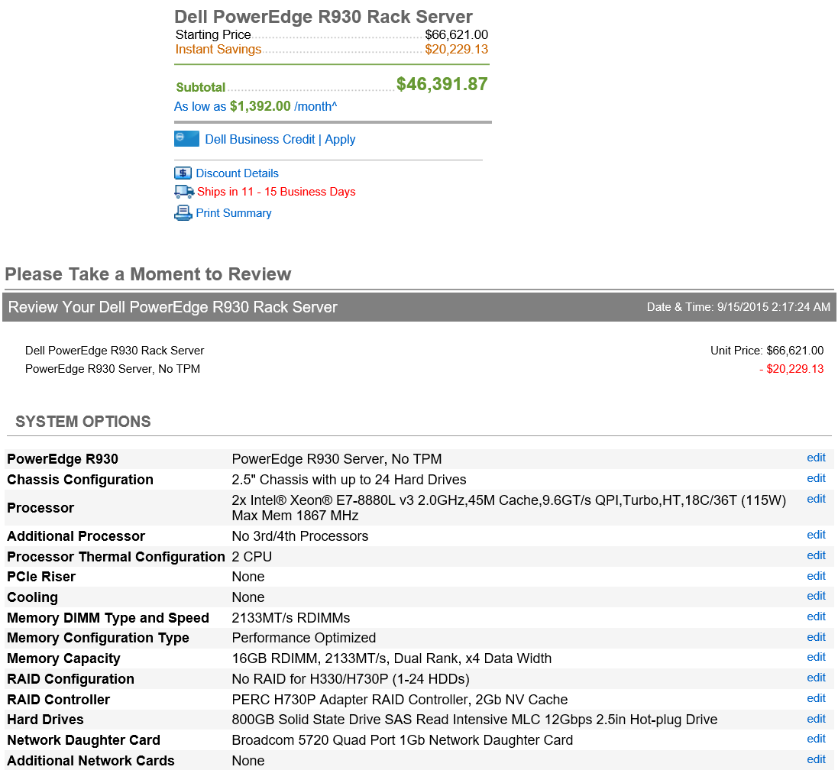
The G family
G
Optimized for data workloads
Up to 32 CPU cores, 448 GB RAM
6.5 TB local SSD
Latest generation Intel processor
Up to 64 attached disks!!

Slide 12
Demo: Managing VMs using Azure portal
Notes:
Demo: Provisioning VM
Prerequisites:
A Windows Server 2012 is already provisioned.
Steps:
Open Ibiza portal and click the NEW button at the lower-left corner.
Show the short list of resources. Explain that I can directly create popular resources here such as a Windows Server 2012.
Click on the Everything link.
In Gallery blade, open the Virtual machines category.
Scroll down the view and show images of different types (refer back to slide 9).
Click on Windows Server 2012 R2, and then click the Create button in the overview blade. For non-Microsoft focused audience, consider to pick a Linux image instead.
Fill in the Create VM form and click on the Create button to provision the VM. Explain this will take a few minutes.
Open the already provisioned VM.
Scroll down the blade to show various of information available on the blade.
Click on the Extensions tile.
On the Extensions blade, click on the ADD icon to bring up the extension list. Introduce that VM extensions are installable components to customize VM instances.
Switch to slides to continue with VM extension introduction.

Slide 13
Microsoft Linux

Slide 14
Virtual Networks

Slide 15
Azure Virtual Networks
A protected private virtual network in cloud
Extend enterprise networks into Azure
Cross-premises connectivity

Slide 16
Virtual Network Scenarios
Hybrid Public/Private Cloud
Enterprise app in Microsoft Azure requiring connectivity to on-premise resources
Enterprise Identity and Access Control
Manage identity and access control with on-premise resources (on-premises Active Directory)
Monitoring and Management
Remote monitoring and trouble-shooting of resources running in Azure
Advanced Connectivity Requirements
Cloud deployments requiring IP addresses and direct connectivity across services
Microsoft Azure

Slide 17






Cross-premises Connectivity
Site-to-site
Create a secure connection between your on-premises site and your virtual network
Point-to-site
Create a secure connection via VPN to your virtual network
ExpressRouteTM
Create a private connection between Azure data centers and infrastructures on your premises or in a co-location environment.
Connect at an ExpressRoute location (Exchange Provider facility)
Direct connect via a Network Service Provider
Microsoft Azure

Slide 18
Virtual Machine Availability
Meaning of 9’s
Fault domains, update domains and availability sets
Load balancing

Slide 19
Meaning of 9’s
Service Availability(%) | System Type | Annualized Down Minutes | Quarterly Down Minutes | Monthly Down Minutes | Practical Meaning | FAA rating
90 | Unmanaged | 52,596.00 | 13,149.00 | 4,383.00 | Down 5 weeks per year
99 | Managed | 5,259.60 | 1,314.90 | 438.30 | Down 4 days per year | ROUTINE
99.9 | Well managed | 525.96 | 131.49 | 43.83 | Down 9 hours per year | ESSENTIAL
99.99 | Fault tolerant | 52.60 | 13.15 | 4.38 | Down 1 hour per year
From Generic Requirements for Operation Systems Platform Reliability, Telcordia Technologies System Documentation,GR-2841-CORE and
Federation Aviation Administration Handbook: Reliability, Maintainability, and Availability (RMA) Handbook, FAA-HDBK-006A, Jan 7, 2008.
Microsoft Azure

Slide 20
Meaning of 9’s
Service Availability(%) | System Type | Annualized Down Minutes | Quarterly Down Minutes | Monthly Down Minutes | Practical Meaning | FAA rating
99.999 | High availability | 5.26 | 1.31 | 0.44 | Down 5 minutes per year | CRITICAL
99.9999 | Very high availability | 0.53 | 0.13 | 0.04 | Down 30 seconds per year
99.99999 | Ultra availability | 0.05 | 0.01 | - | Down 3 seconds per year | SAFETY CRITICAL
From Generic Requirements for Operation Systems Platform Reliability, Telcordia Technologies System Documentation,GR-2841-CORE and
Federation Aviation Administration Handbook: Reliability, Maintainability, and Availability (RMA) Handbook, FAA-HDBK-006A, Jan 7, 2008.
Microsoft Azure

Slide 21

Service Level Agreements
99.95% for multiple role instances
4.38 hours of downtime per year
What’s included
Compute Hardware failure (disk, CPU, memory)
Datacenter failures - Network failure, power failure
Hardware upgrades, Software maintenance – Host OS Updates
What is not included
VM Container crashes, Guest OS Updates

Slide 22
Image Mobility
On-Premises
Cloud
MyApp.vhd
Notes:
Slide Objective:
Explain the benefits of image mobility
Notes:
One of the key benefits of IaaS is flexibility and control. The Microsoft Azure solution provides the capability of not only moving VHDs TO the cloud but also allows you to copy the VHD back down and run it locally or on another cloud provider. Great for testing out production issues or any other need where you require a copy of the production server.

Slide 23

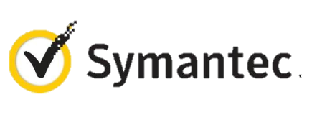




VM Extensions
Installable components to customize VM instances
Enable various DevOps scenarios
Can be added, updated, disabled or removed at any time
Managed via portal, PowerShell and Management APIs
Microsoft Azure
Notes:
Slide Objective:
Introduce VM extensions.
Speaker Notes:
No matter how big the image gallery is, your projects may have specific needs that can’t be satisfied by standard images.
Some components such as anti-virus, configuration management agents are required on most machines for compliance and management purposes.
This allows use to innovate faster to meet with your project needs. And you have flexibility to pick and combine extensions for your goals.
Point out some of existing extensions:
Custom Script Extension, which allows you to download and execute PowerShell scripts.
Chef Extension and Puppet Extension for automated management at scale.
Symantec Endpoint Protection etc. for protection.
Docker (Linux only).
Visual Studio Remote Debugger.

Slide 24
Demo: Add an extension to a VM instance
Notes:
Demo: VM Extension
Prerequisites:
Azure PowerShell v0.8 or higher has been installed and configured.
Desired Azure subscription has already been selected.
A storage account has been provisioned under the same Azure subscription.
A scripts container has been created under the storage account with public read access.
A helloworld.ps1 PowerShell script has been uploaded to the container. The content of the script is a single line: write-output “Hello World!”
PowerShell environment has been set with large font for easy reading.
A Windows Server 2012 VM has been provisioned.
Steps:
In Azure PowerShell, issue command: Get-AzureVMAvailableExtension | Format-Table -Property ExtensionName, Publisher
The above cmdlet lists existing extensions. Next we’ll see how we can inject an extension to a running VM instance. In the last demo you’ve seen that you can achieve this using Azure Management Portal. Here we’ll do it using PowerShell. In this case, we’ll install Custom Script Extension to an existing Windows Server 2012 VM.
Issue the following cmdlets to get a reference to the virtual machine instance:
$serviceName = “[cloud service that hosts the VM]”
$vmName = “[name of the VM]”
$vm = Get-AzureVM –ServiceName $serviceName –Name $vmName
Next, issue command Get-AzureVMExtension –VM $vm. This lists VM extensions that are currently installed on the VM.
Use the following cmdlet to enable Custom Script Extension, and instruct it to download and execute the helloworld.ps1 (this takes about 20-30 seconds):
Set-AzureVMCustomScriptExtension -ContainerName scripts -StorageAccountName '[your storage account name]' -VM $vm -FileName ‘helloworld.ps1' -Run ‘helloworld.ps1' | Update-AzureVM -Verbose
6. Next, we’ll retrieve and display the script execution result:
$status = Get-AzureVM -ServiceName $serviceName -Name $vmName
$result = $status.ResourceExtensionStatusList.ExtensionSettingStatus.SubStatusList | Select Name, @{"Label"="Message";Expression = {$_.FormattedMessage.Message }}
$result |fl
(see screenshots in hidden slides for references)
(see this blog: http://azure.microsoft.com/blog/2014/07/15/automating-sql-server-vm-configuration-using-custom-script-extension/ for more details on Custom Script Extension)

Slide 25
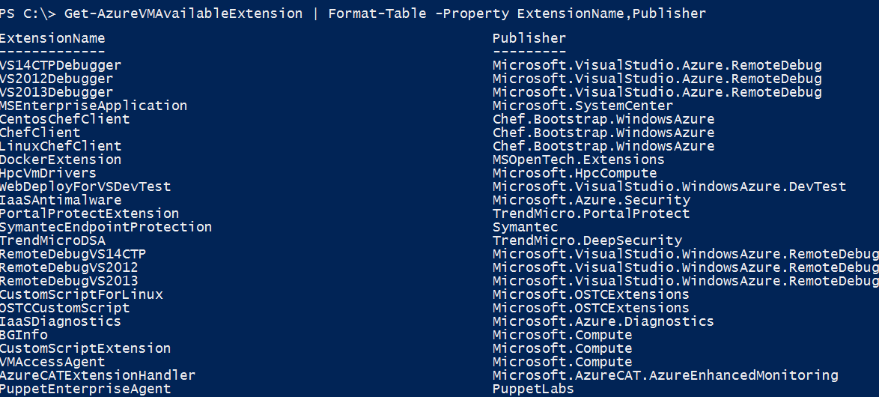
VM Extensions
List available VM extensions
Microsoft Azure

Slide 26
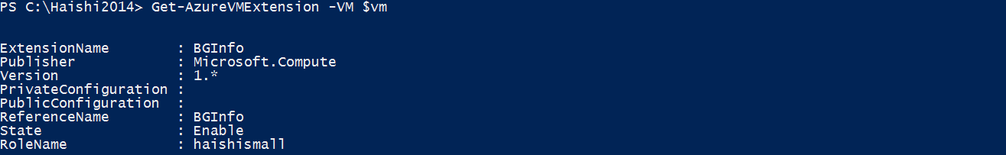
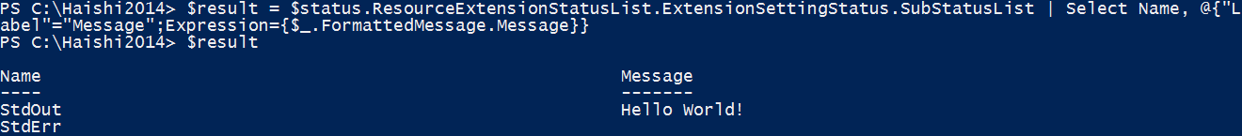
VM Extensions
Before Custom Script Extension is installed
Script execution result
Microsoft Azure

Slide 27
Azure Files vs Disks
Before Custom Script Extension is installed
Description | Disk | Azure Files
Relationship with Azure VMs | Required for booting (OS Disk)
Scope | Exclusive/Isolated to a single VM | Shared access across multiple VMs
Snapshots and Copy | Yes | No
Configuration | Configured via portal/Management APIs and available at boot time | Connect after boot (via net use on windows)
Built-in authentication | Built-in authentication | Set up authentication on net use
Cleanup | Resources can be cleaned up with VM if needed | Manually via standard file APIs or REST APIs
Access via REST | Can only access as fixed formatted VHD (single blob) via REST. Files stored in VHD cannot be accessed via REST. | Individual files stored in share are accessible via REST
Max Size | 1TB Disk | 5TB File Share 1TB file within share
Max 8KB IOps | 500 IOps | 1000 IOps
Throughput | Up to 60 MB/s per Disk | Up to 60 MB/s per File Share
Notes:
Speaker Notes:
Unhide to add more details if necessary

Slide 28
Demo: Virtual Network Point-to-Site Connection
Notes:
Demo: Point-to-Site connection
Prerequisites:
Follow step 1-15 below to prepare the environment.
(http://haishibai.blogspot.com/2013/05/walkthrough-file-sharing-between-your.html)
Steps:
Run through steps 17-21 in the following steps. If time permits, you can start with step 16.
Log on to (current) Microsoft Azure Management Portal.
On command bar, click on NEW button, then select NETWORKS->VIRTUAL NETWORK->CUSTOM CREATE menu.
On Virtual Network Details page, enter network NAME as pointtosite, create or select a AFFINITY GROUP, then click next arrow.
On DNS Servers and VPN Connectivity page, check Configure Point-to-Site VPN, then click next arrow:
On Point-to-Site Connectivity page, click next arrow.
On Virtual Network Address Spaces page, click on add gateway subnet button, and then click on check icon to complete network creation.
After the virtual network has been created, open its DASHBOARD page, and the click CREATE GATEWAY icon to create the dynamic routing gateway.
Add a new Windows Server 2012 virtual machine to the virtual network. Note that when you specify user credential, make sure to use the same user id and password of your local account. This is because the virtual machine on Microsoft Azure is not under your domain controller, and we are using the same user credential on both local and virtual machines to allow file sharing.
As the virtual machine is cooking, let’s create two self-signed certificates: one for root, and another for client identification. During the following steps we’ll need to upload the root certificate to Microsoft Azure so Microsoft Azure can validate the client machine using the certificate chain.
Launch Developer Command Prompt for VS2012 as administrator. Change current folder to a folder where you want to keep the generated certificates. Here I’ll use folder c:\books.
Use command makecert -sky exchange -r -n "CN=MyFakeRoot" -pe -a sha1 -len 2048 -ss My to create root certificate.
Use command makecert -n "CN=MyLaptop" -pe -sky exchange -m 96 -ss My -in "MyFakeRoot" -is my -a sha1 to create client certificate.
Launch certmgr. Export the root certificate as a MyFakeRoot.cer file (without private key).
[Optional] if you are configuring VPN for another client, you’d need to install the client certificate on target machine.
Go back to Microsoft Azure Management Portal. On DASHBOARD page of the virtual network, click on link Upload client certificate to upload the root certificate. Note at this point the gateway should have been created.
After certificate has been uploaded, you can download and install VPN client from the DASHBOARD page (AMD64 Client link for 64-bit machines, x86 Client link for 32-bit machines).
After VPN client has been installed, you can see the VPN connection on your Windows network connection list. Click on the network to connect. When prompted by the VPN client, click Connect button to continue.
[Optional] Now you can use ipconfig/all to verify if VPN connection has been successfully established (look for PPP adapter).
Log on to the virtual machine, create a new Share folder under c:\. Share the folder with the user you specified when you created the virtual machine.
On Management Portal, record the virtual machines private IP on its DASHBOARD page. In my case the IP is 10.0.1.4.
Now you can use Explorer on your local machine and access the shared folder by \\10.0.1.4\Share.

Slide 29


Get started
Visit azure.microsoft.com

